Slide 1

animal species classification
Aashif Ali N
Panimalar Institute of Technology
B.E. CSE
Naan Mudhalvan ID : au211521104001
E-Mail ID : aashifali398@gmail.com

Slide 2
PROBLEM STATEMENT
The goal of developing a convolutional neural network (CNN) for animal species classification is
to address the difficulty of accurately discriminating between different species using visual data.
This project aims to optimize model performance to enable reliable classification of various
species, boosting biodiversity monitoring and conservation activities. The dataset consists of five
animals organized into five different folders.

Slide 3
PROBLEM solution
Convolutional Neural Network (CNN)
A Convolutional Neural Network (CNN) is a type of deep learning algorithm primarily designed for analyzing visual data. CNNs are widely used in tasks such as image recognition, object detection, and image segmentation.
Convolutional Layers: These layers consist of filters (also called kernels) that slide over the input image to perform convolution operations.
Activation Functions: Typically, activation functions like ReLU (Rectified Linear Unit) are applied after convolutional operations to introduce non-linearity into the network, enabling it to learn complex patterns and relationships in the data.
Pooling Layers: Pooling layers (commonly max pooling or average pooling) are used to reduce the spatial dimensions of the feature maps produced by the convolutional layers.
Fully Connected Layers: After several convolutional and pooling layers, the feature maps are flattened into a vector and passed through one or more fully connected (dense) layers.
Loss Function: In classification tasks, CNNs typically use a loss function such as cross-entropy loss to measure the difference between predicted and actual class labels during training.
Optimizer: CNNs employ optimization algorithms like SGD, Adam, or RMSprop to update the network parameters (weights and biases) based on the gradients of the loss function with respect to the parameters.

Slide 4
SYStem approach
System Requirements:
Hardware:
CPU: A modern multi-core CPU (e.g., Intel Core i5 or AMD Ryzen 5) is sufficient for development and training small-scale CNN models.
GPU: For faster training of larger models or handling extensive datasets, you may benefit from having a GPU. NVIDIA GPUs, particularly those supported by CUDA and cuDNN libraries, are commonly used for deep learning tasks. Popular choices include NVIDIA GeForce GTX/RTX series for personal use or NVIDIA Tesla for professional environments.
RAM: At least 8GB of RAM is recommended for basic development and training. For larger models or datasets, more RAM may be beneficial.
Storage: Adequate storage space is required to store datasets, trained models, and related files. SSDs are preferred over HDDs for faster data access speeds, which can be beneficial during training and inference.

Slide 5
Software:
Python: TensorFlow and most machine learning libraries are primarily supported in Python. Make sure you have Python installed
TensorFlow: Install TensorFlow using pip or conda. Ensure you have the GPU-supported version if you plan to use GPU acceleration.
Development Environment: Choose a preferred code editor or IDE for Python development. Popular choices include Visual Studio Code, PyCharm, or Jupyter Notebooks.
Additional Libraries: Install other required Python libraries such as NumPy, Matplotlib, and OpenCV for data manipulation, visualization, and image processing tasks.
CUDA and cuDNN : If you have an NVIDIA GPU, install CUDA and cuDNN libraries to enable GPU acceleration for TensorFlow.
Internet Connection: A stable internet connection is necessary for downloading datasets, pre-trained models , and additional libraries.

Slide 6


Algorithm & Deployment
Data Preparation: The code utilizes the ImageDataGenerator class from TensorFlow/Keras to prepare the training and validation datasets.
Model Architecture: The CNN model is constructed using the Sequential API of Keras. It consists of several convolutional layers (Conv2D) followed by max-pooling layers (MaxPooling2D), which help in extracting and learning spatial features from the input images.
Model Compilation: The model is compiled using the Adam optimizer and categorical cross-entropy loss function.
Training: The model is trained using the fit method, where the training and validation datasets are passed along with other parameters such as batch size (BATCH_SIZE), number of epochs (EPOCHS), and callbacks for early stopping and TensorBoard visualization.

Slide 7
Algorithm & Deployment & (contd..)
Monitoring Accuracy: A custom callback named moniter_accuracy is implemented to monitor the accuracy during training. If the accuracy exceeds 99%, training is stopped early to prevent overfitting.
Model Saving: Once training is completed, the trained model is saved to a file named 'animal.h5' using the model.save() method.
DEPLOYMENT
The trained CNN model and associated code are deployed into a GitHub repository.
Included instructions for setting up the environment and running the code.Created documentation and README files explaining the project, algorithm, and deployment instructions.

Slide 8
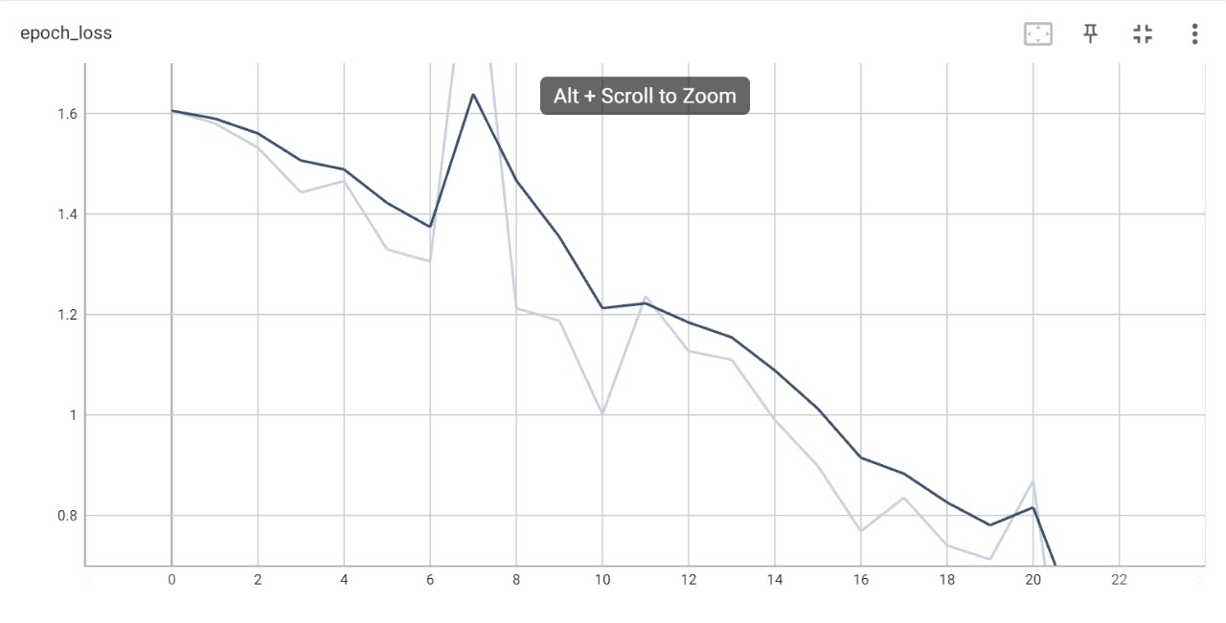
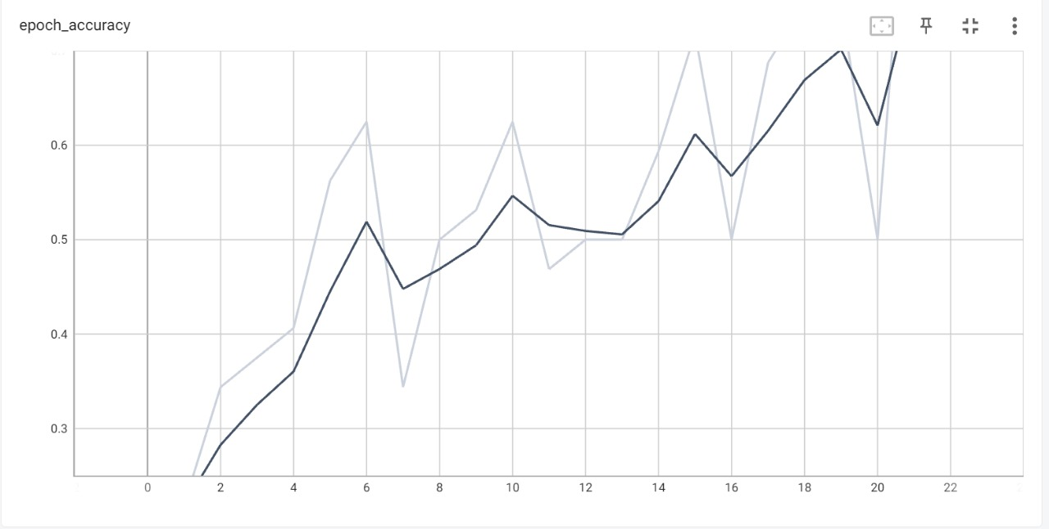
result

Slide 9
conclusion
Using TensorFlow and Keras, the project effectively develops a Convolutional Neural Network (CNN) for the classification of animal species. All things considered, the experiment shows that classifying animal species using deep learning techniques is feasible and lays the groundwork for future research and application in the fields of computer vision and biodiversity protection.

Slide 10

references
https://www.tensorflow.org/
https://keras.io/
https://www.coursera.org/specializations/deep-learning
"Deep Learning" by Ian Goodfellow, Yoshua Bengio, and Aaron Courville
Websites like Stack Overflow, Reddit
(e.g., r/MachineLearning)

